Slide 1
Relationships Between Weather and Home Sales
Team 4
Katie Harris
Betsy King
Wenbo Sun
James Shin

Slide 2
Our Hypotheses
Core Hypothesis: There is a relationship between home sales across the country and specific weather patterns.
We chose to look at four key weather variables: temperature, humidity levels, amount of precipitation, and amount of cloud cover, to answer the following questions:
Home sales are higher in warmer months (i.e., summer rather than winter)
Home sales are higher in less humid weather
Home sales are higher when precipitation is lower (i.e., more snow in winter = less home sales)
Home sales are higher when cloud cover is lower (i.e., more home sales in summer than winter)
With the data we collected and resulting analysis, we were able to answer each of our questions and had some interesting conclusions.
We confirmed that home sales are higher in warmer months
While home sales are generally higher in less humid weather, this is really dependent on region
We learned that home sales actually tend to be higher when precipitation is higher; the amount of precipitation appears to be driven by rainfall amounts (not snowfall) and the summer months have higher precipitation; the West region is the one exception
Home sales are higher when cloud cover is lower (less cloudy in the summer months)

Slide 3


Data Sources and Extraction
To answer our hypothesis, the following data sources were used:
Zillow releases data for new and existing home sales across the country that is NOT seasonally adjusted
The Visual Crossing Weather API provides historical weather data that can be summarized by month and year
Data Extractions Steps:
The Zillow data set includes sales information for over 20,000 US cities; we narrowed this to the top 1,000 most populous cities.
The Zillow data was aggregated to 3 years of monthly data (2017, 2018, 2019).
The weather data collected from Visual Crossing was also at a monthly level combining the same three years of data.
Challenges with Zillow: There was not a lot of data for less populated cities; although Zillow collects back to 2008, there was a lot of missing data for earlier years
Challenges with Visual Crossing: The free trial API Key allowed limited data to be pulled each day which required splitting the data set into smaller chunks of data to use multiple keys over two days.

Slide 4
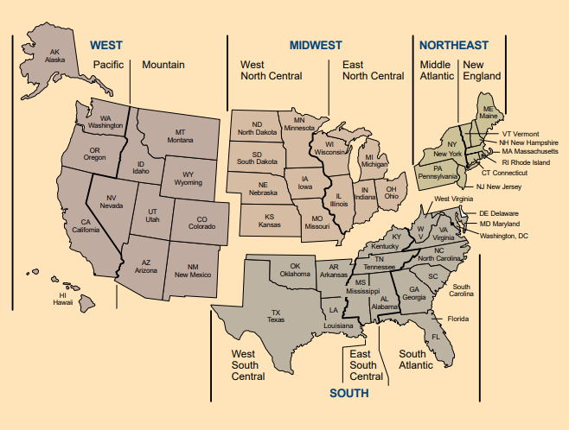
Data Cleaning and Initial Exploration
Cleaning the data brought our total number of cities to 922:
The Zillow data did not include data for all of the top 1,000 most populous US cities
Some cities did not have a full 3 years of data in our time period (2017 -2019); all cities with missing values were eliminated
The cities were grouped into regions based on the four primary US Census region definitions: Northeast, Midwest, South, and West
Our initial data exploration showed that the monthly home sales across the twelve months was consistent (outliers not indicated) and aligned with the population distribution by region
FOUR REGIONS |  |  | Home Sale Counts by Month
 | Population |  | Jan | Feb | Mar | Apr | May | Jun | Jul | Aug | Sep | Oct | Nov | Dec
Northeast (NE) | 15.3% |  | 9.3% | 7.9% | 7.3% | 7.2% | 7.2% | 7.6% | 8.0% | 8.2% | 8.3% | 8.3% | 8.5% | 8.5%
Midwest (MW) | 16.9% |  | 17.2% | 16.0% | 16.5% | 17.2% | 18.2% | 19.1% | 19.1% | 18.9% | 18.9% | 18.9% | 18.4% | 17.6%
South (SO) | 32.4% |  | 40.8% | 42.4% | 42.2% | 41.9% | 41.3% | 40.4% | 40.3% | 40.1% | 39.4% | 39.7% | 39.9% | 41.7%
West (WE) | 35.4% |  | 32.6% | 33.8% | 34.0% | 33.7% | 33.3% | 33.0% | 32.7% | 32.8% | 33.4% | 33.1% | 33.2% | 32.2%

Slide 5
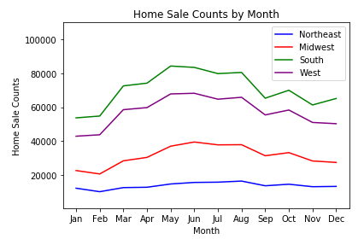
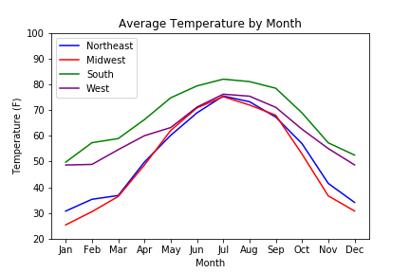
Home Sales are Strongly Correlated with Temperature
Home sales and temperatures are positively correlated: as temperatures increase, home sales go up.
This is consistent across all regions but highest in the Midwest and lowest in the South – likely due to the range of temperatures within those regions:
Midwest spans from a low of 25 degrees in January to a high of 75 degrees in July (a 50 degree difference) while South spans from a low of 50 degrees in January to a high of 82 degrees in July (a 32 degree difference).
 | Total | NE | MW | SO | WE
Correlation of Home Sales & Temperature | 0.84 | 0.85 | 0.91 | 0.78 | 0.81

Slide 6
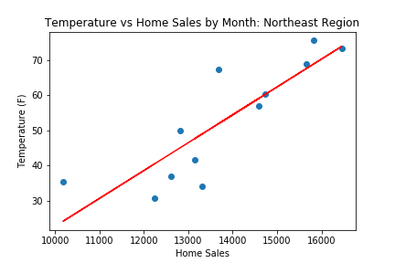
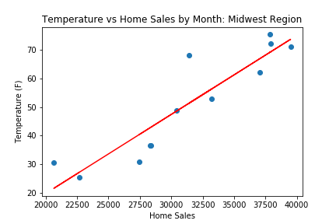
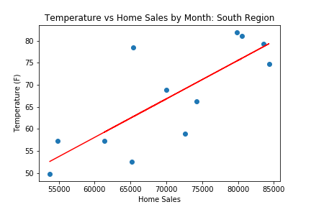
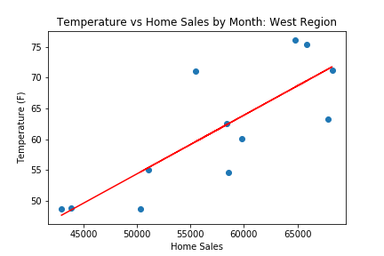
There is a Positive Linear Relationship Between Home Sales and Temperature
The positive linear relationship (as temperatures increase, home sales increase) is seen for all four regions with high R-squared values.
 | NE | MW | SO | WE
R-squared Value: | 72% | 83% | 61% | 65%

Slide 7
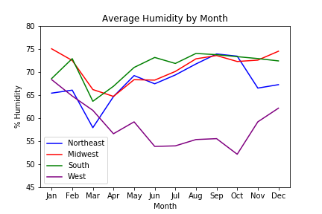
Home Sales and Humidity Levels are Moderately Correlated
Generally, there is a negative correlation between home sales and the amount of humidity: as humidity decreases, home sales go up.
This is driven by the West region where humidity is low in the summer months when home sales are highest.
There is almost no correlation between home sales and humidity in the South region where humidity levels tend to be more consistent.
 | Total | NE | MW | SO | WE
Correlation of Home Sales & Humidity | -0.62 | 0.52 | -0.35 | 0.02 | -0.76

Slide 8
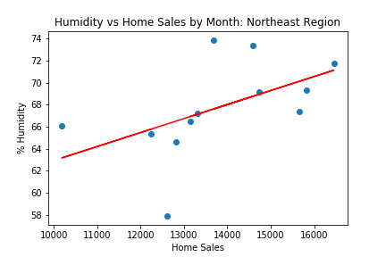
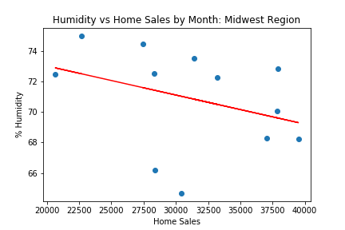
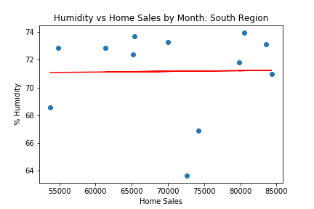
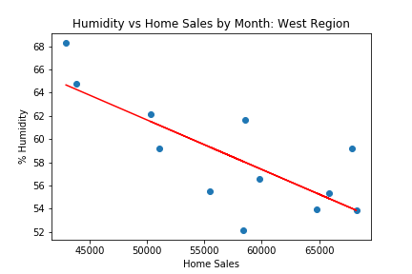
The Relationship Between Home Sales and Humidity Differs by Region
The relationship between humidity and home sales is strongest in the West region which tends to have lower humidity in the summer months when home sales are high.
 | NE | MW | SO | WE
R-squared Value: | 27% | 12% | 0% | 58%

Slide 9
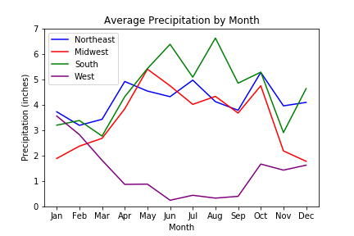
Home Sales Generally have a Strong Correlation with Precipitation
For most regions, there is a positive correlation between home sales and the amount of precipitation: as levels of precipitation increase, home sales go up. In most regions, precipitation is highest in the summer when home sales are also higher.
The exception is the West region in which there is a negative correlation: precipitation level are low in this region especially in the summer when home sales are highest.
 | Total | NE | MW | SO | WE
Correlation of Home Sales & Precipitation | 0.60 | 0.61 | 0.85 | 0.73 | -0.85

Slide 10
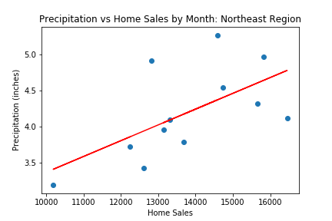
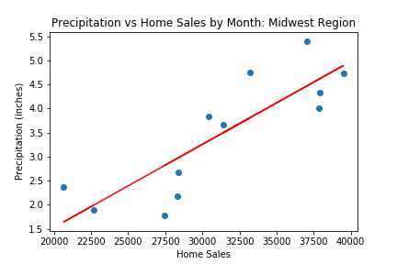
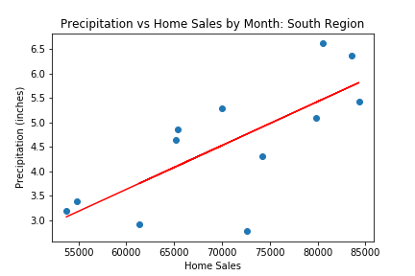
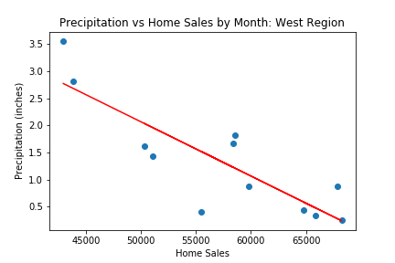
A Positive Relationship Between Home Sales and Precipitation is Most Common
While most regions have a positive linear relationship between home sales and precipitation, for the West region, this relationship is negative.
 | NE | MW | SO | WE
R-squared Value: | 37% | 72% | 54% | 72%

Slide 11
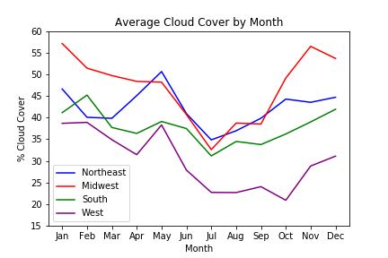
Home Sales and Cloud Cover are Correlated in Certain Regions
The Midwest region has fairly strong negative correlation between home sales and the amount of cloud cover: as cloud cover decreases, home sales go up.
The South region has a similar relationship but the correlation is weaker in the Northeast and West.
Cloud cover is lowest in the summer months when home sales are highest and appears to be most pronounced for the Midwest region which has the highest levels of cloud cover during the winter months with its lowest spike in July.
 | Total | NE | MW | SO | WE
Correlation of Home Sales & Cloud Cover | -0.64 | -0.26 | -0.75 | -0.61 | -0.45

Slide 12
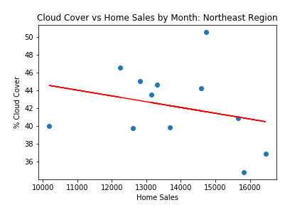
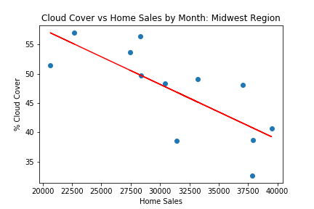
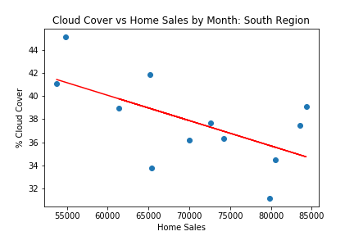
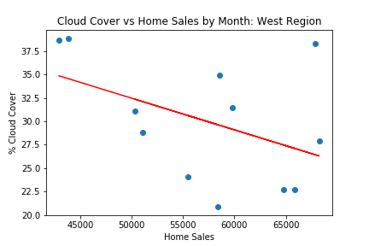
There is a Negative Linear Relationship Between Home Sales and Cloud Cover
While the negative linear relationship between home sales and cloud cover is seen for all four regions, it is strongest in the Midwest region.
 | NE | MW | SO | WE
R-squared Value: | 7% | 56% | 37% | 20%

Slide 13
Conclusions
There are relationships between home sales across the country and different weather patterns.
Across all four regions, home sales are higher in when temperatures are higher (i.e., in the summer months). Temperature has the strongest relationship with home sales and has an impact on trends seen with the other weather variables.
The relationship between home sales and humidity level differs by region:
In the West, home sales are higher when humidity is lower since the summer months tend to have lower humidity levels. The same relationship also exists in the Midwest.
In the South, humidity does not vary a lot during the year so humidity levels are not related to home sales.
In the Northeast, home sales are actually higher when humidity is higher but the relationship is fairly weak.
Home sales are higher when precipitation is higher for most regions (Northeast, Midwest, South) as the amount of precipitation is higher in the summer months, when home sales are higher.
The exception is the West region which has low precipitation levels in the summer months.
Home sales are higher when cloud cover is lower as it tends to be sunnier in the summer months; the relationship is stronger in some regions and weaker in others.

Slide 14
What Would We Do Next?
Look at the regions at a more granular level using the 9 US Census Regions
The Northeast Region had very flat home sales in comparison to the other regions so perhaps breaking it up into the two smaller regions (Middle Atlantic and New England) would show some differences
The South and West regions are very large so breaking both of these regions into the smaller region segments could yield some interesting differences
Do more complex analysis/modeling which will consider the relationships between the different weather variables
Incorporate other variables besides weather that could impact home sales at different times of the year

Slide 15
Q & A

